Slide 1

Notes:
Intro - Itoki
How it works - Avery
How it’s doing/stats - Nicola
Compétition - Nicola
About us - Mehdi
Website - Rayan

Slide 2

Uneed

Slide 3


Slide 4
?
Notes:
Avery

Slide 5
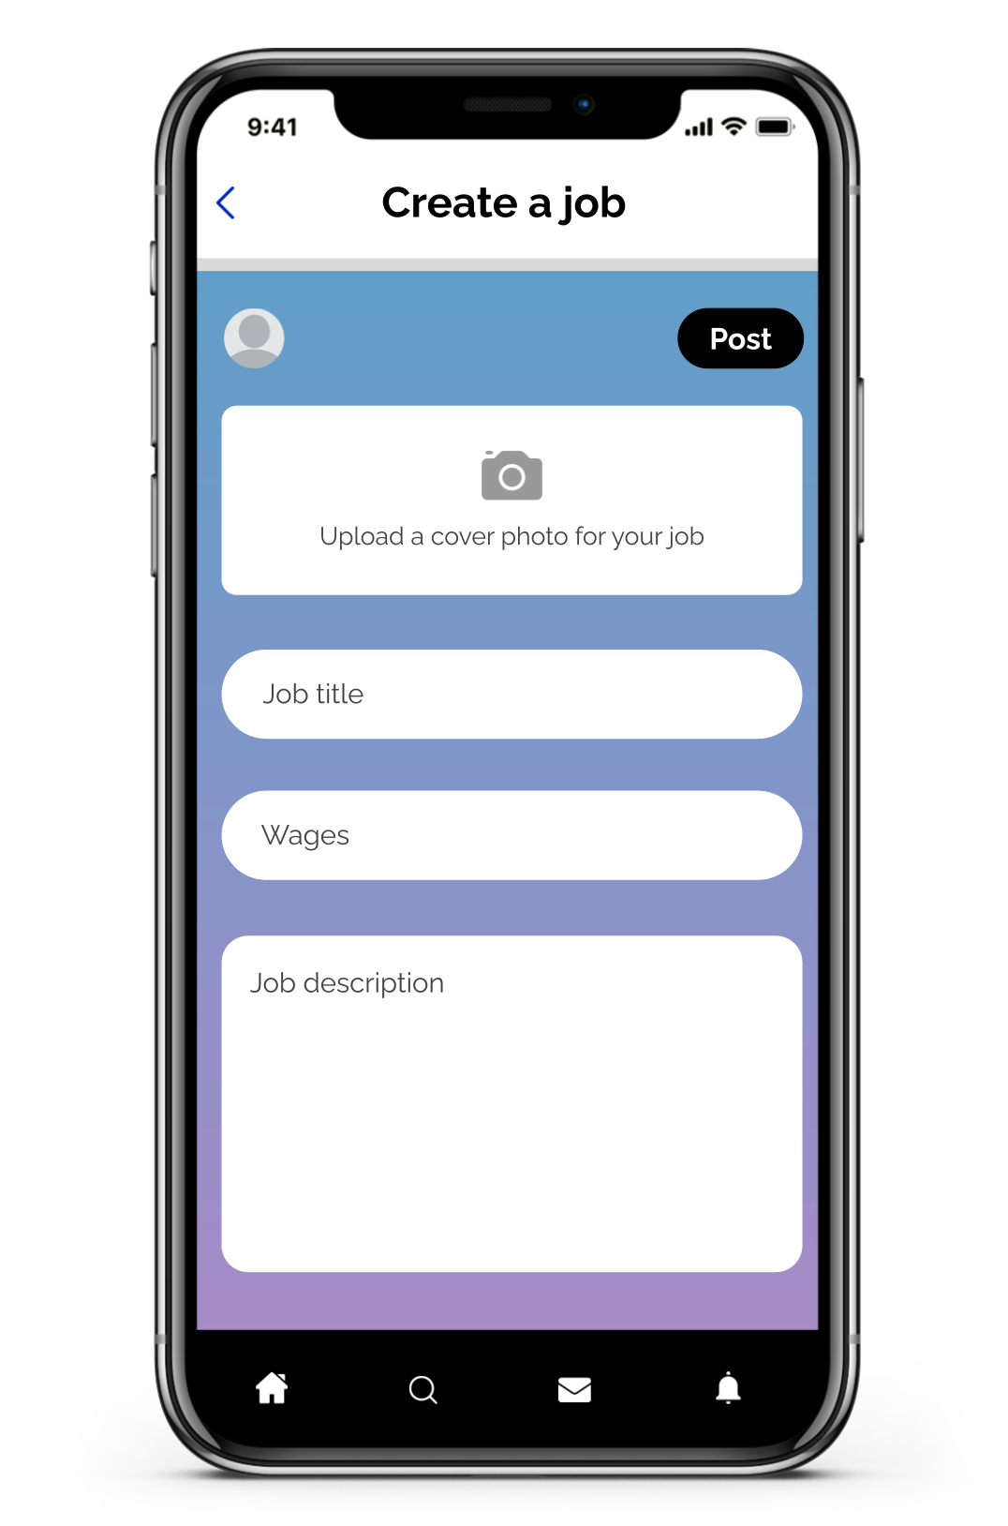
Notes:
Avery
How Uneed app?
2 main functionalities:
First: creating jobs, ask your community for help when you need it
Customizability (reference to image)

Slide 6
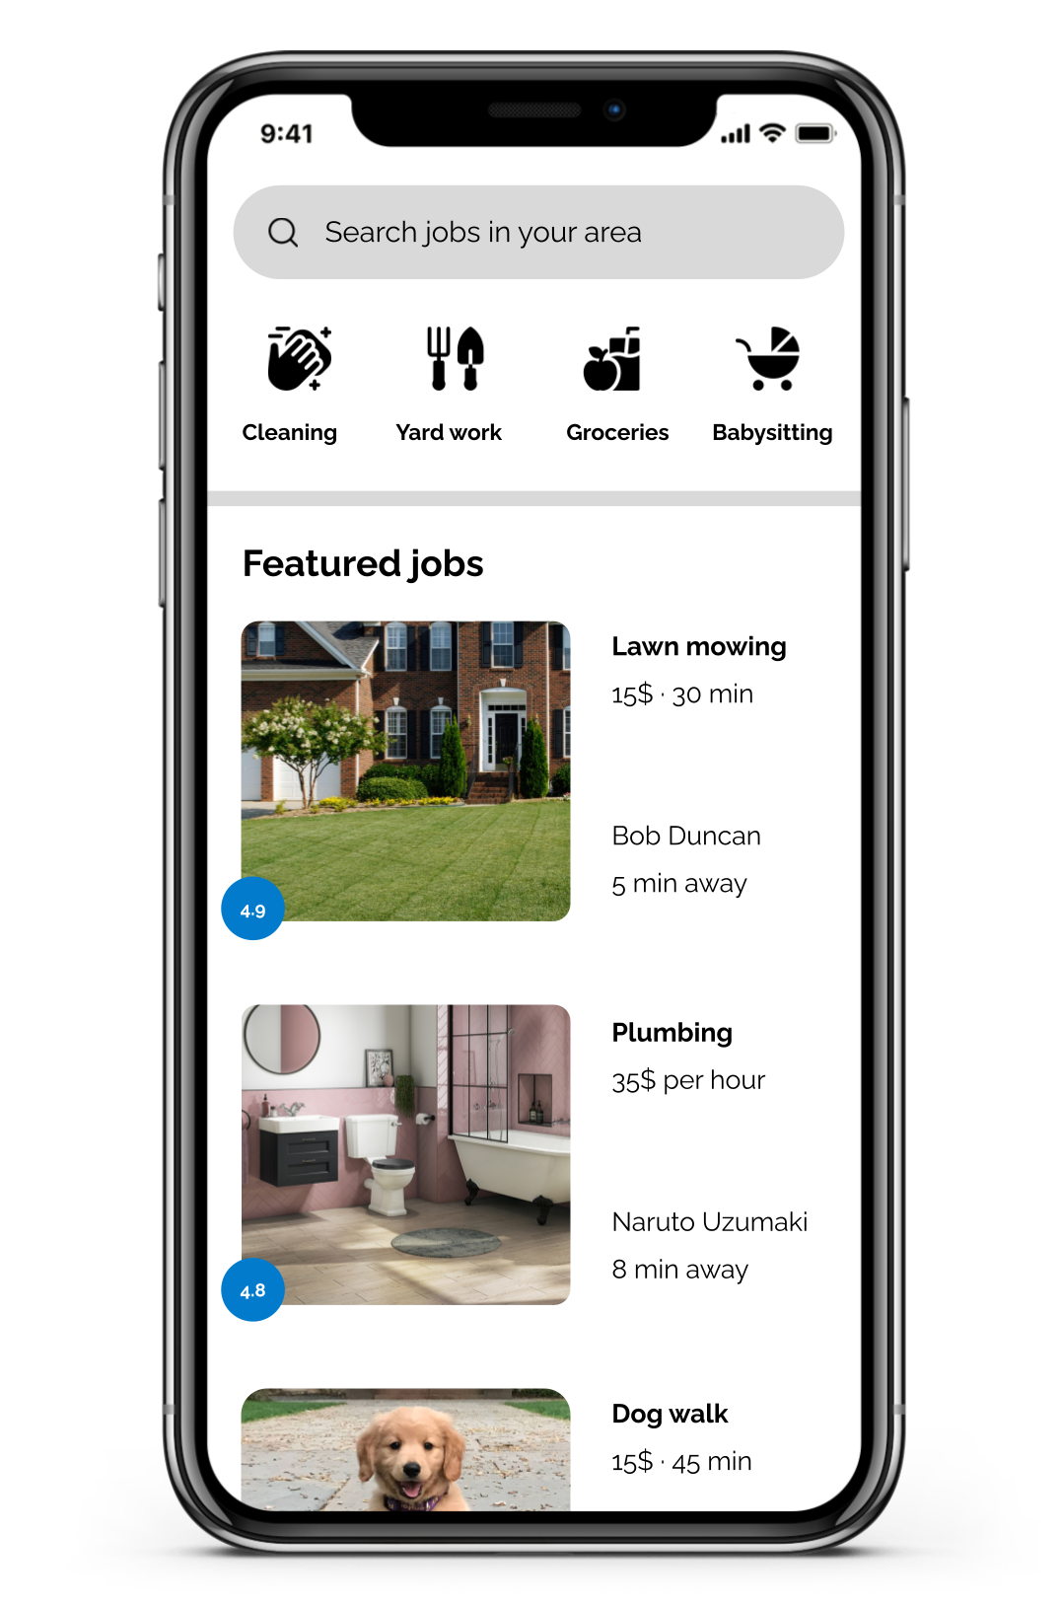
Notes:
Avery
Second: finding jobs
Excellent for kids that are too young to work and still looking to make money, simple tasks
Popular jobs: repairs, cleaning, babysitting

Slide 7

Notes:
Avery

Slide 8


Slide 9


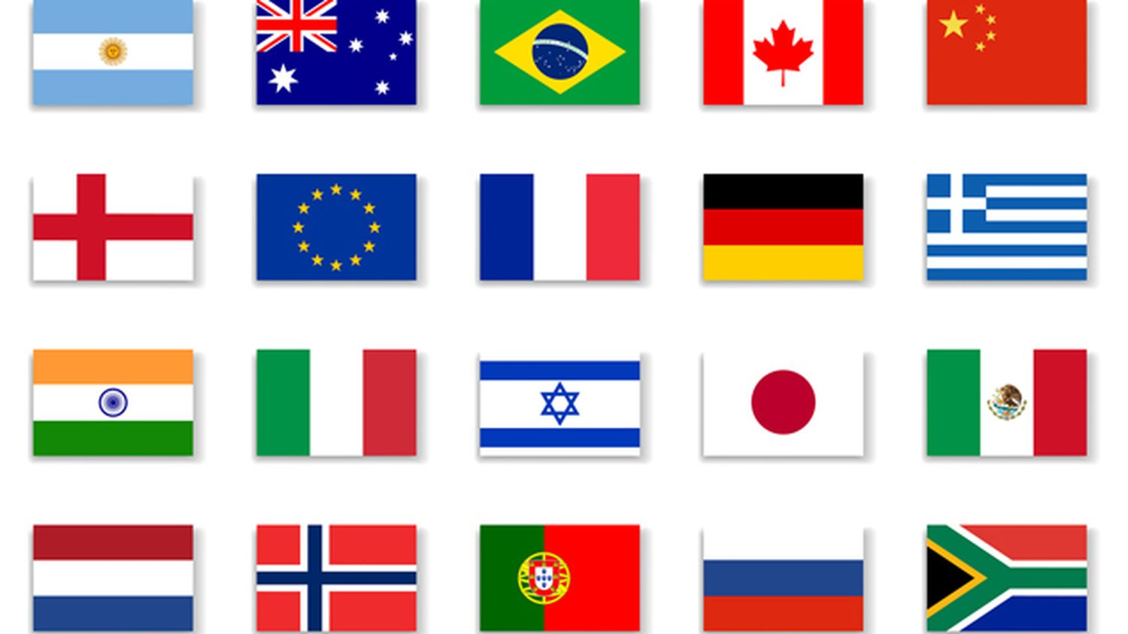




23 000
250 000
13
1 000 000
Villes
Notes:
Stats

Slide 10



Notes:
Compétition

Slide 11

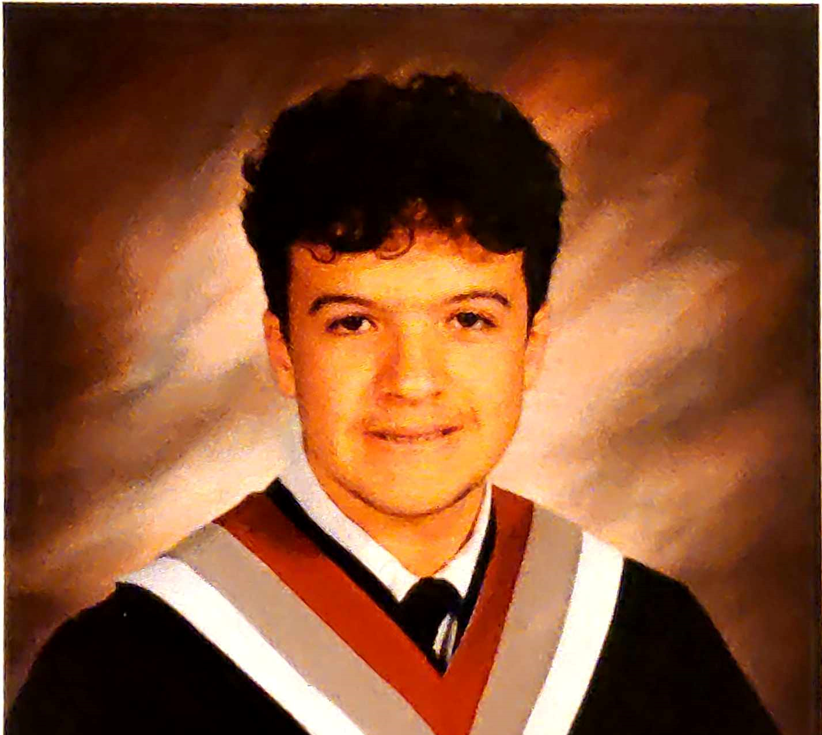
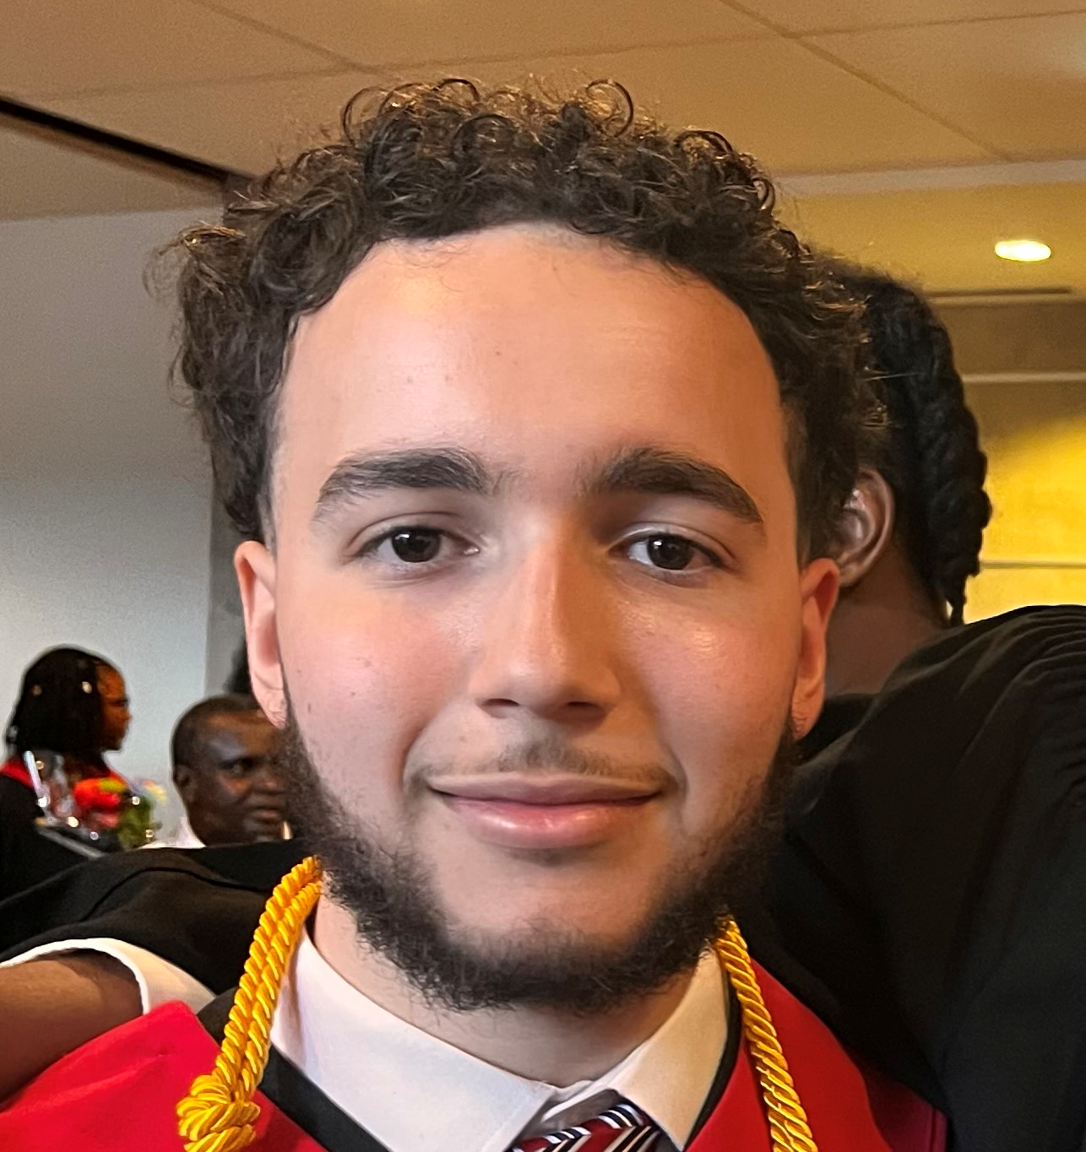
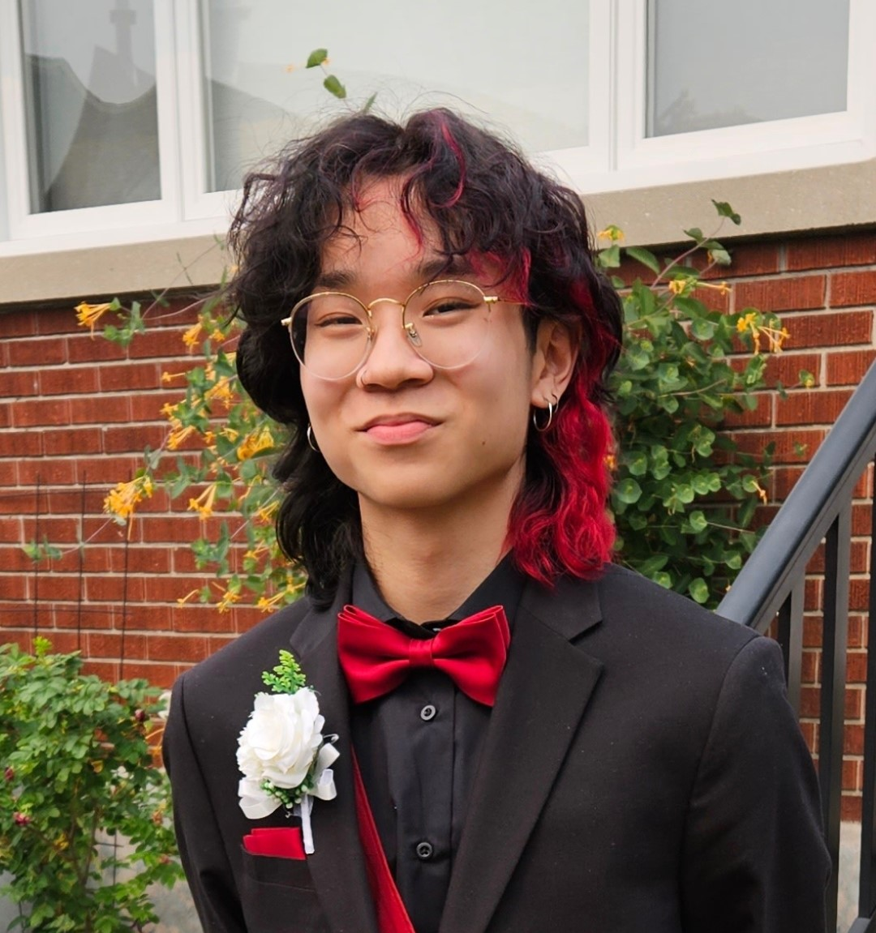
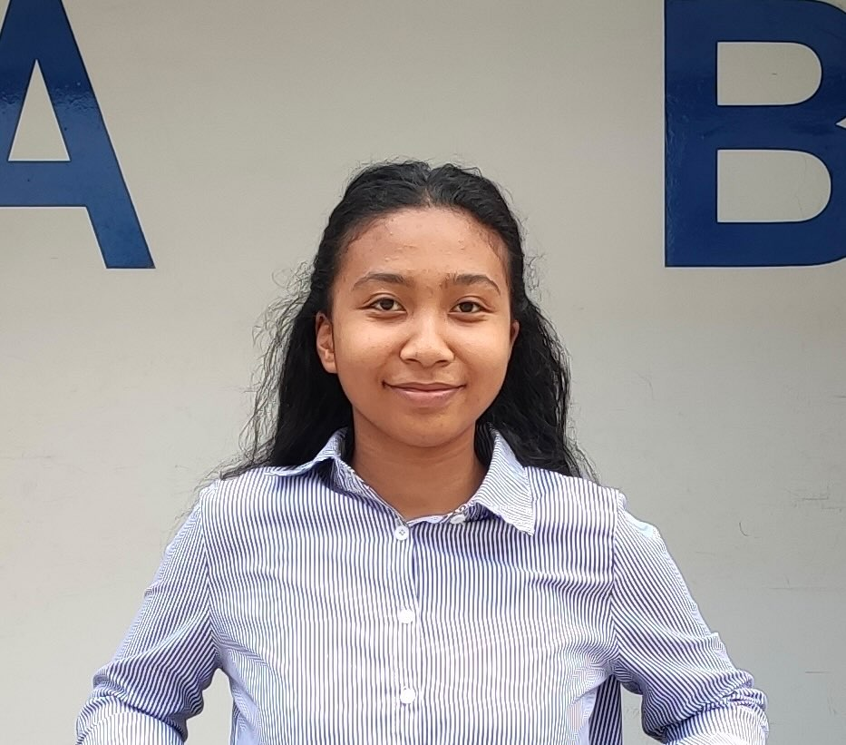
Our Team

Slide 12
DEMO OF OUR
MARKETING WEBSITE

